Slide 1
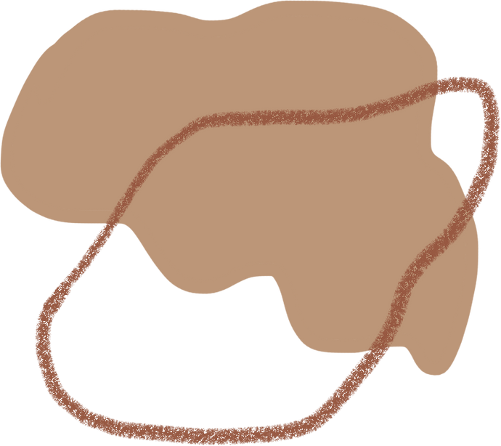

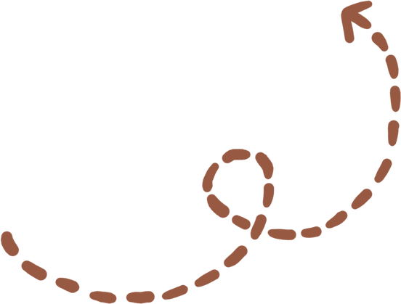



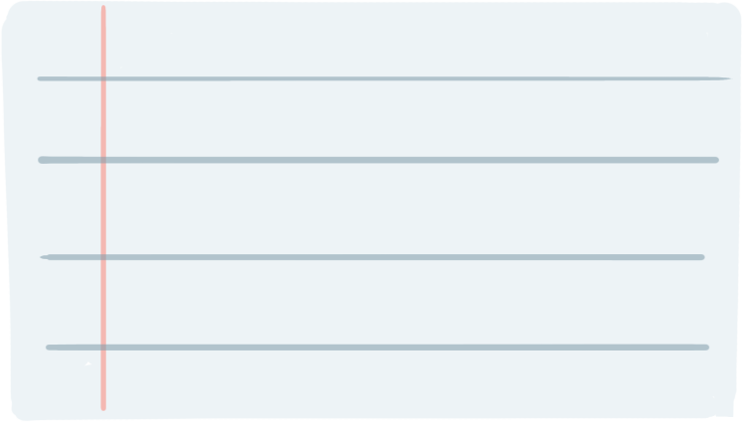
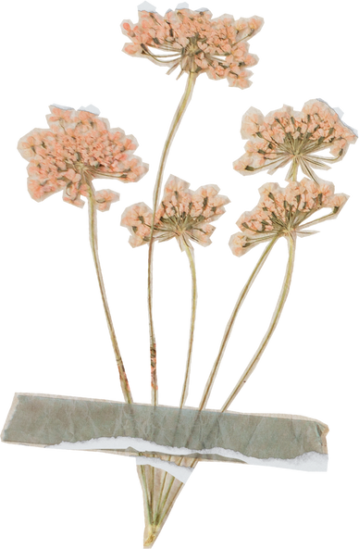
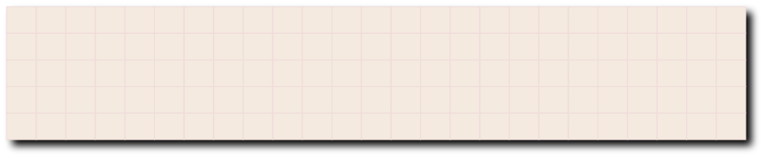



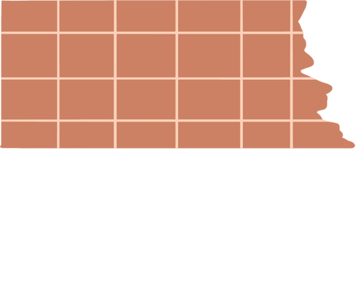
digital Portfolio
STUDENT NAME:M.Varshini
REGISTER NO AND NMID:24h247 and 138753E23A00D4690C3448F36A3FBF6A
DEPORTMENT:BCA
COLLEGE:A.M.Jain College

Slide 2
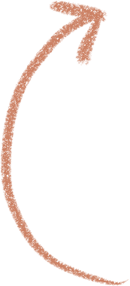



PROJECT TITLE
Web Developer Portfolio

Slide 3




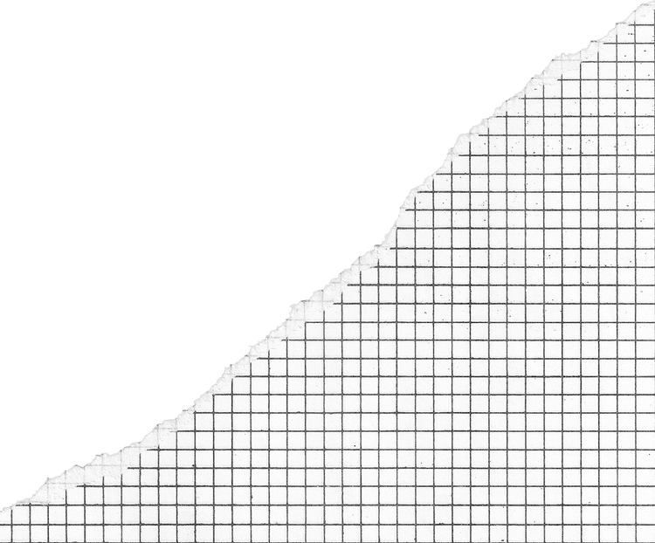
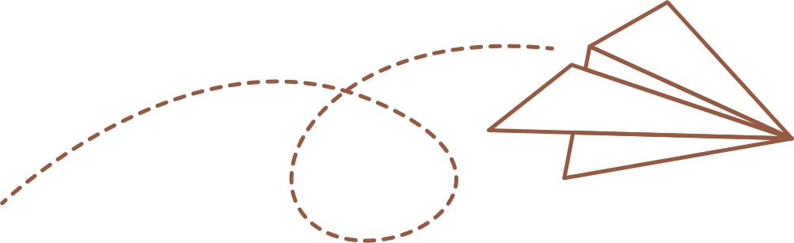
agenda
Problem Statement
Project Overview
End Users
Tools and Technologies
Portfolio design and Layout
Features and Functionality
Results and Screenshots
Conclusion
Github Link

Slide 4



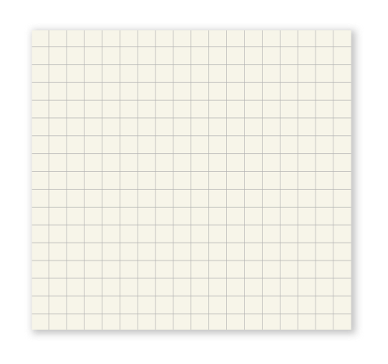

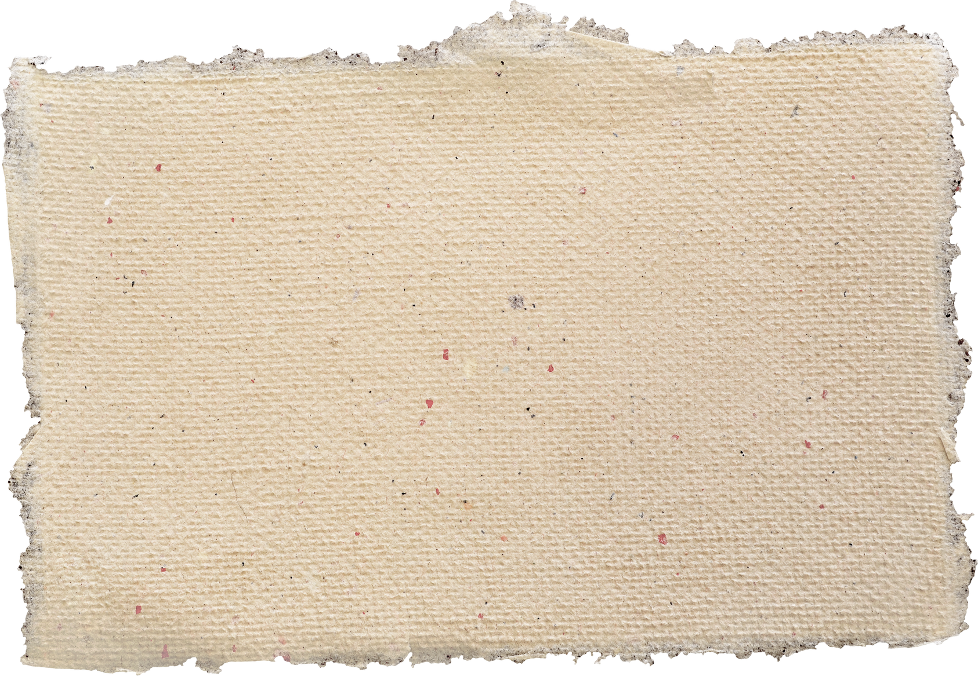
PROBLEM STATEMENT
THE PROBLEM STATEMENT IS TO CREATE A RESPONSIVE PERSONAL PORTFOLIO WEBSITE FOR A WEB DEVELOPER NAMED M.VARSHINI THAT SHOWCASES SKILLS, PROJECTS, AND CONTACT INFORMATION WITH AN INTERACTIVE NAVIGATION MENU AND SMOOTH USER EXPERIENCE.

Slide 5



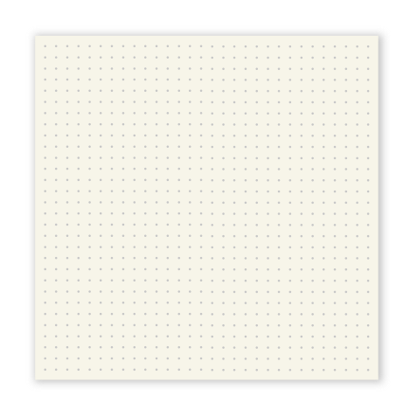
PROJECT OVERVIEW
This project is a responsive personal portfolio website for M. Varshini, showcasing her skills in HTML5, CSS3, and JavaScript. It highlights a modern e-commerce project, includes a functional contact form, and features smooth scrolling, a mobile-friendly menu, and interactive elements for an engaging user experience.

Slide 6

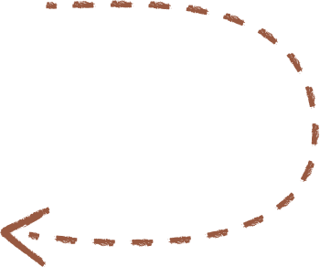


WHO ARE THE END USERS?
THE END USERS OF THIS PORTFOLIO WEBSITE ARE POTENTIAL EMPLOYERS, FREELANCE CLIENTS, AND PROJECT COLLABORATORS WHO WANT TO LEARN ABOUT M.VARSHINI'S WEB DEVELOPMENT SKILLS, VIEW HER PROJECTS, AND CONTACT HER FOR WORK OPPORTUNITIES OR COLLABORATIONS

Slide 7
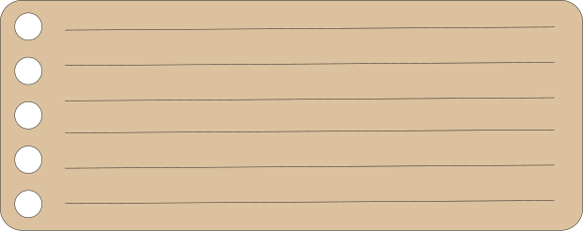
TOOLS AND TECHNIQUES
The portfolio website is built using HTML5 for semantic structure, CSS3 with Flexbox, Grid, animations, and variables for styling and layout, and JavaScript for interactivity like menu toggling, smooth scrolling, back-to-top button, and form validation. It also uses Font Awesome icons via CDN and follows responsive design principles to ensure a seamless experience across all devices.

Slide 8

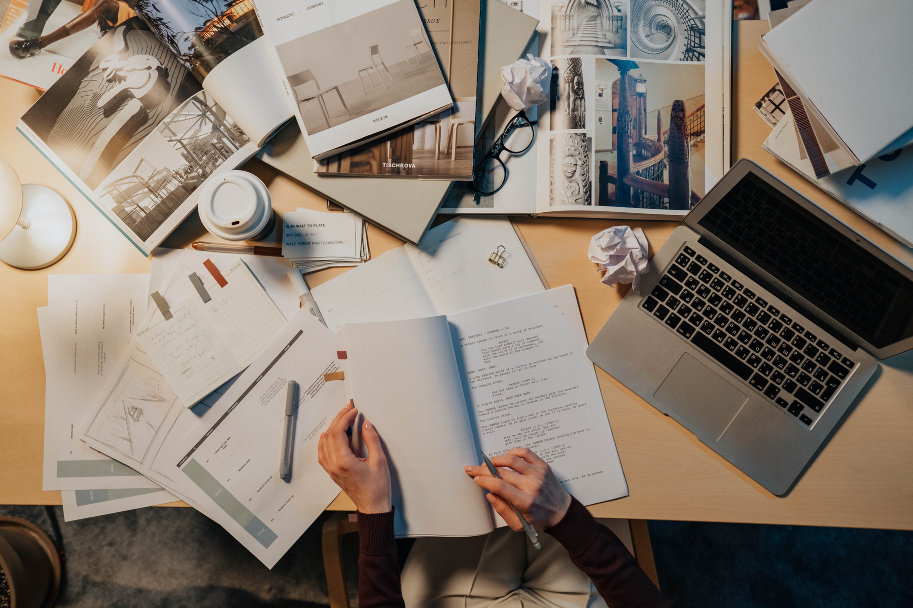


POTFOLIO DESIGN AND LAYOUT
The portfolio features a fixed header with a mobile-friendly hamburger menu, a hero section introducing the developer, skills displayed in cards with icons, a project showcase with summaries and tech tags, and a contact section with details and a submission form. It also includes a footer with social links and copyright, along with smooth scrolling and a back-to-top button for improved user experience.

Slide 9

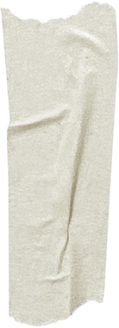
FEATURES AND FUNCTIONALITy
FEATURES AND FUNCTIONALITY
RESPONSIVE DESIGN FOR ALL DEVICES.
FIXED HEADER WITH SMOOTH NAVIGATION AND MOBILE HAMBURGER MENU.
SKILLS AND PROJECT DISPLAYED WITH ICONS AND TAGS.
INTERACTIVE CONTACT FORM AND CONTACT INFO.
SOCIAL MEDIA LINKS AND BACK TO TOP BUTTON.
SMOOTH SCROLLING AND SUBTLE ANIMATIONS FOR ENHANCED USER EXPERIENCE.

Slide 10
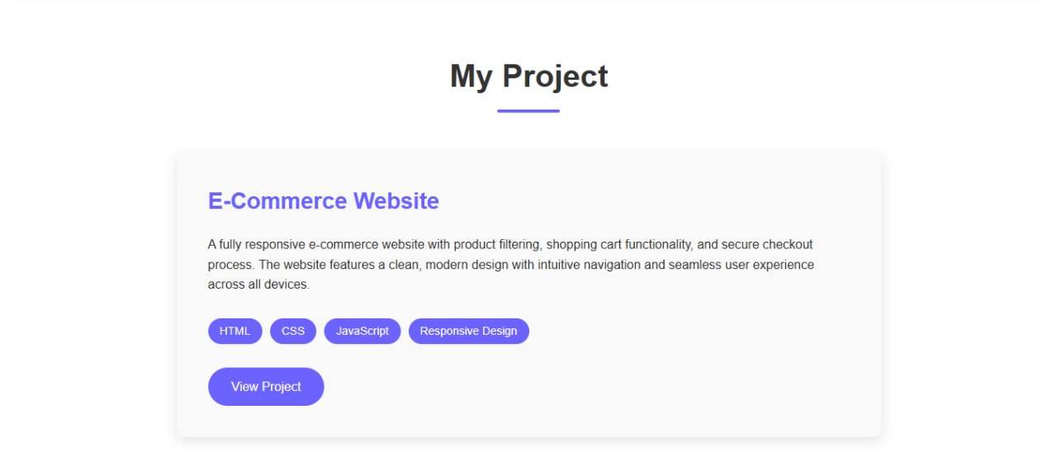
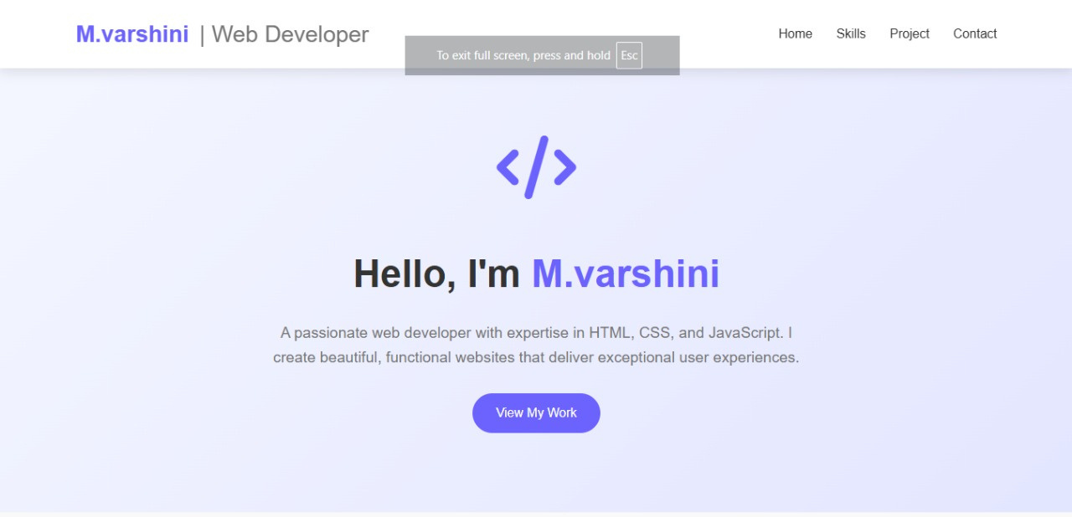
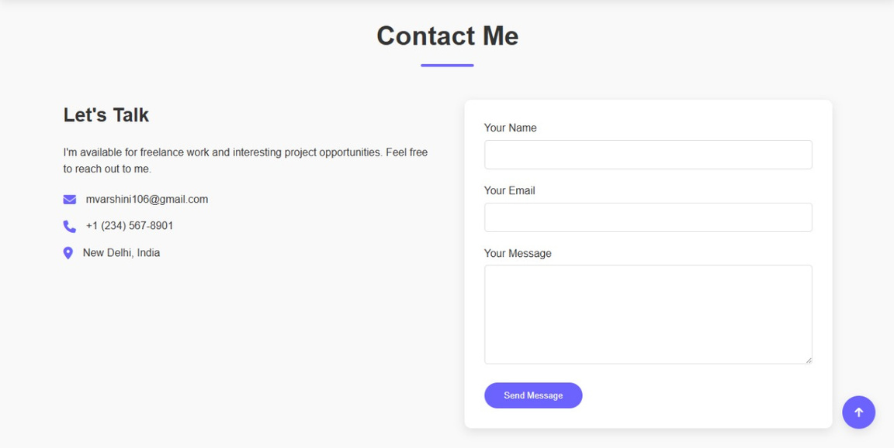
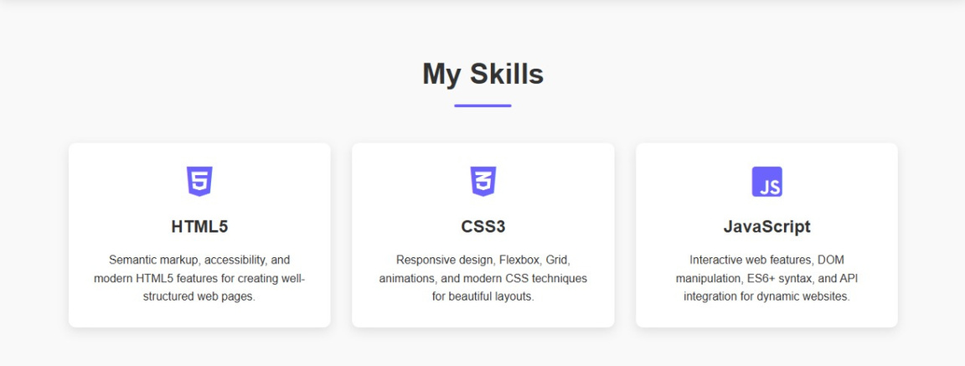
RESULTS AND SCREENSHOTS

Slide 11

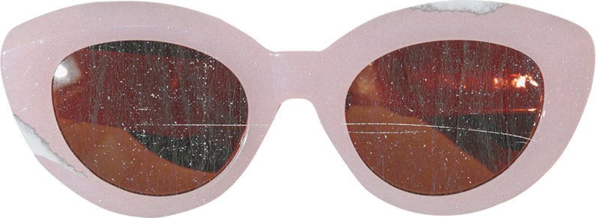
CONCLUSION
M.VARSHINI IS A WEB DEVELOPER SKILLED IN HTML, CSS, AND JAVASCRIPT. SHE BUILDS RESPONSIVE, USER-FRIENDLY WEBSITES AND SHOWCASES HER WORK IN A CLEAN, MODERN PORTFOLIO. SHE IS OPEN TO FREELANCE PROJECTS AND CONTACTABLE THROUGH HER PORTFOLIO SITE.

Slide 12




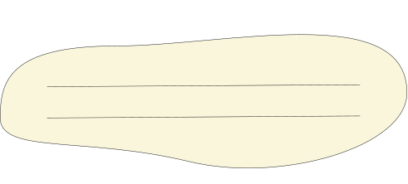
Github Link
24h247-glitch/TNSDC-FWD-DigitalPortfolio
thank you

